Slide 1

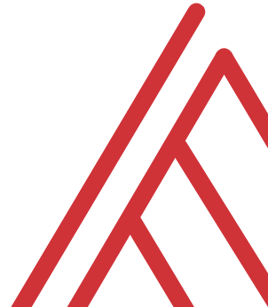
Advancing into Analytics: From Excel to R and Python

Slide 2
Learning objectives
Situate Excel in the data analytics stack
Chart a clear learning path from Excel to R and Python
Demonstrate tangible use cases for combining these tools

Slide 3
Unofficial learning objectives
Having fun with data & computers

Slide 4
What is the data analytics stack?

Slide 5
Spare no tools…
Insert your O’Reilly-drawn data analytics stack image here

Slide 6
What is Excel good for?
Good at…
Visual calculations
End-user interactivity
Rapid prototyping
Not so much…
Storing data
Mobilizing data
Implementing advanced analysis

Slide 7
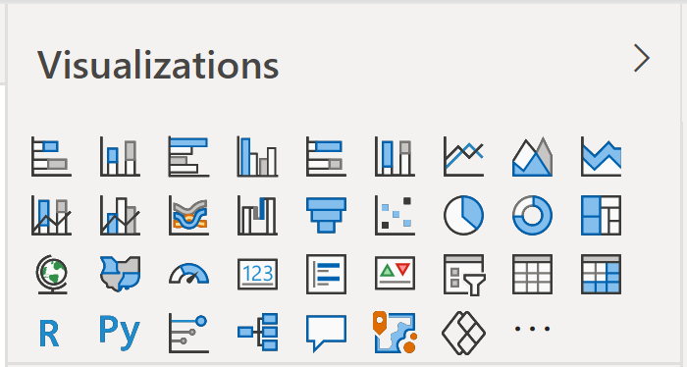
Don’t take my word for it…
Insert Power BI visuals here

Slide 8

Don’t take my word for it…
https://docs.microsoft.com/en-us/archive/blogs/wikininjas/tnwiki-article-spotlight-consuming-azure-storages-python-sdk-using-ptvs

Slide 9
The dialects of data
Adding, removing, calculating columns
Sorting and filtering
Aggregating and joining
Pivoting and reshaping

Slide 10
Welcome to the R Project for Statistical Computing

Slide 11

Packages: “There’s an App for that!”
Install the package
Open the package

Slide 12
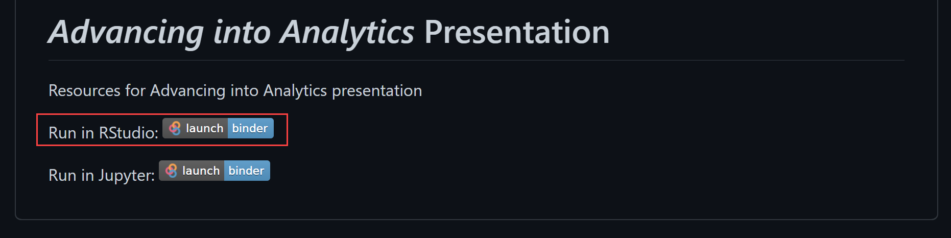

Demo
Navigate RStudio, beginning with 1+1

Slide 13
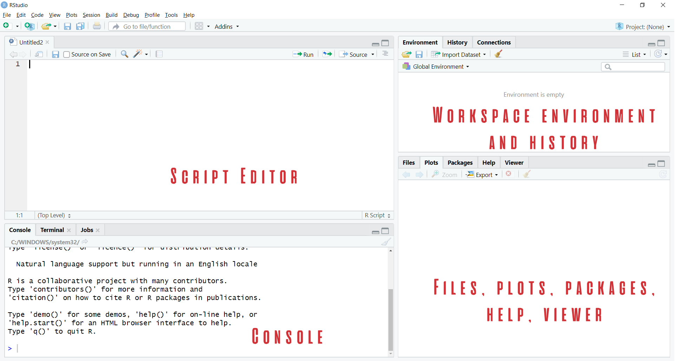
Rstudio Orientation

Slide 14
The dialects of data
Adding, removing, calculating columns
Sorting and filtering
Aggregating and joining
Pivoting and reshaping

Slide 15
Demo
Navigate RStudio, beginning with 1+1

Slide 16
Prancing into Python

Slide 17
The data world is your oyster shell

Slide 18
Demo
Build a
Decoupling of platforms and applications

Slide 19
Questions?

Slide 20
The two basic things to do in R
Run a function
Create or modify an object

Slide 21
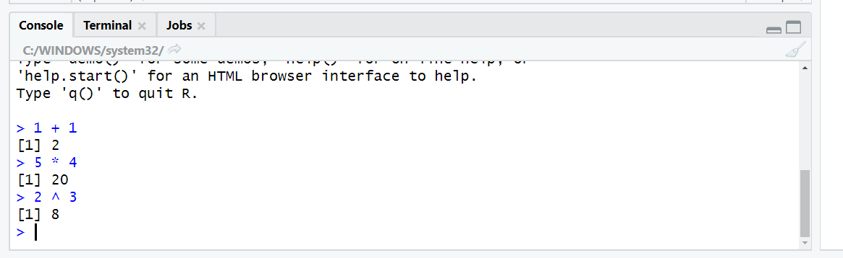
Let’s get working in the console
Use R as a fancy calculator:
Hit Enter to execute

Slide 22
R follows the order of operation and uses scientific notation:
2+3*4/(5+3)*15/2^2+3*4^2
## [1] 55.625
5e4
## [1] 50000

Slide 23
Testing conditions
Condition | Symbol
Equal to | == (not = )
Not equal to | !=
Greater than/less than | >, <
Greater than or equal to/less than or equal to | >=, <=
# Does 5 equal 4?
5 == 4
## [1] FALSE
# Is 10 less than or equal to 11?
10 <= 11
## [1] TRUE
#is the sqrt of 36 equal to 6 squared?
sqrt(36) != 6
## [1] FALSE

Slide 24


Using functions
sqrt(36)
## [1] 6
abs(-5*2)
## [1] 10

Slide 25
R is case-sensitive:
Sqrt(10)
## Error in Sqrt(10): could not find function "Sqrt"

Slide 26
Using functions
sqrt(36)
## [1] 6
abs(-5*2)
## [1] 10

Slide 27
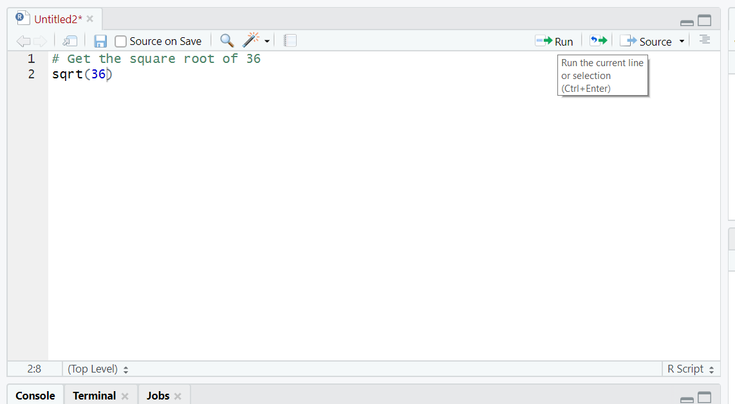
Script: save your code for later

Slide 28
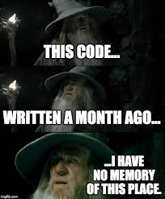
Note to self: use comments (#)

Slide 29
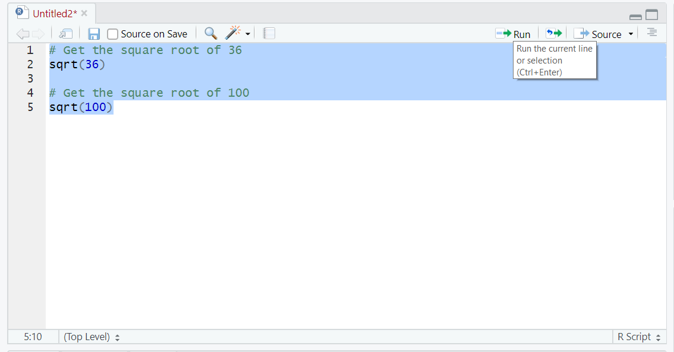
Execute multiple lines

Slide 30
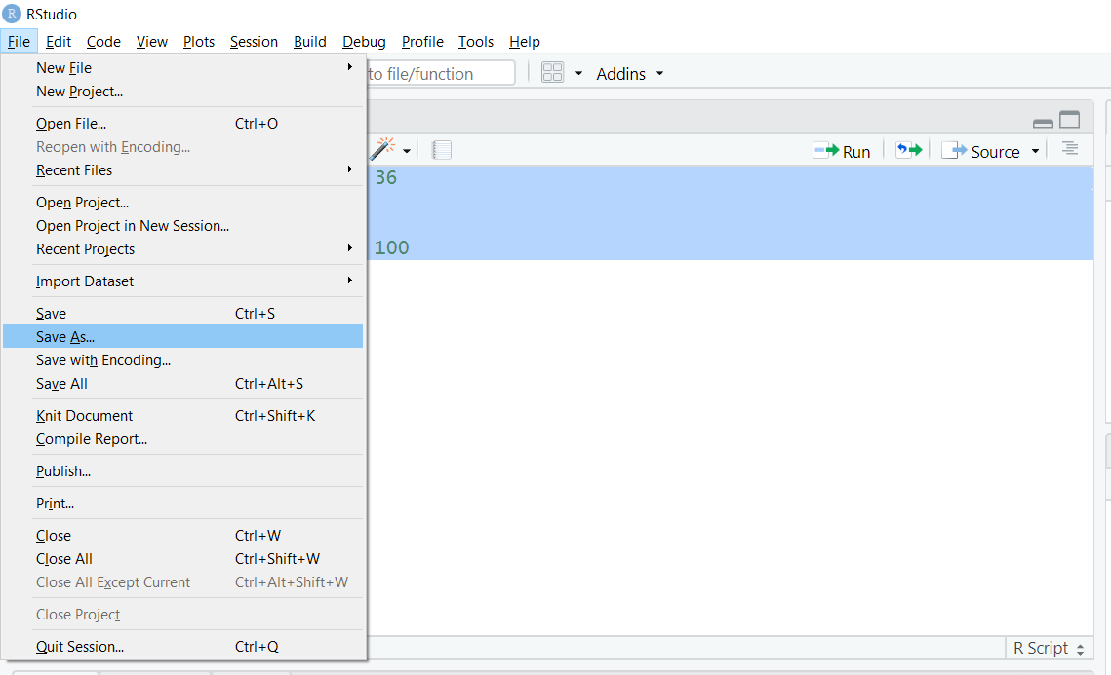
Save your work

Slide 31
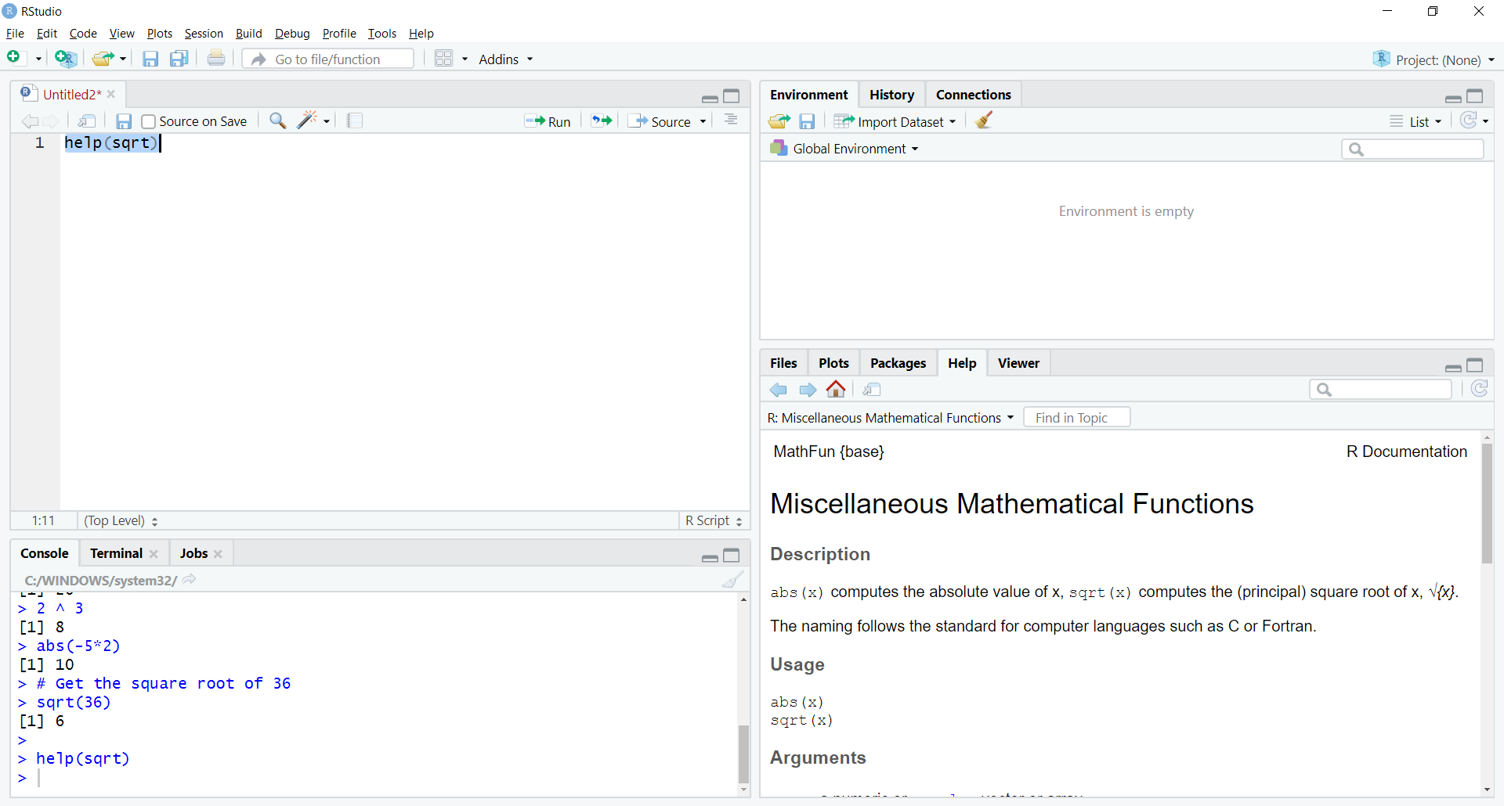
Getting Help (Lower right)

Slide 32
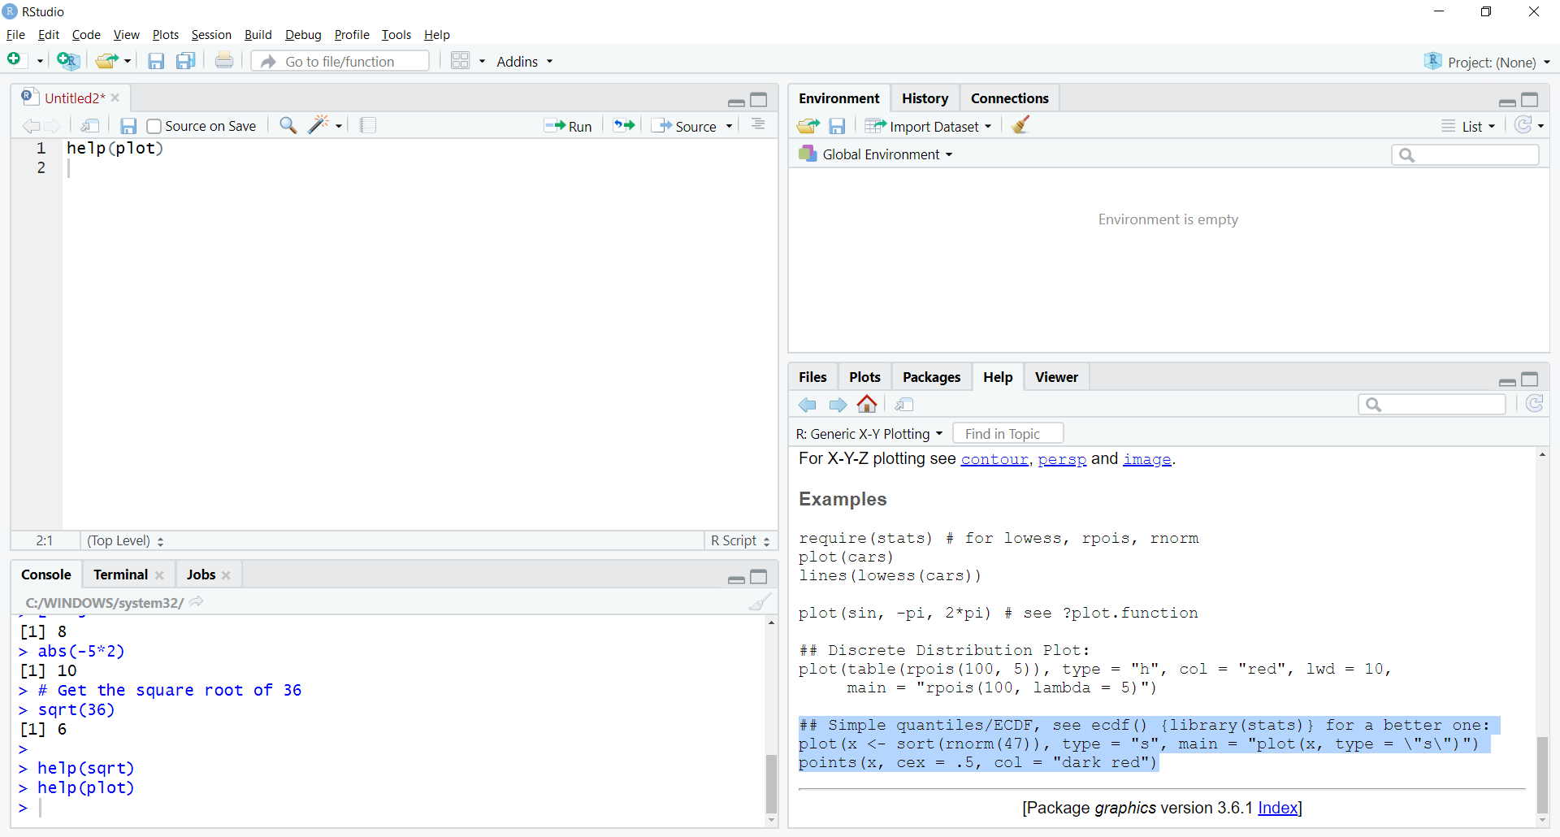
Plotting an example

Slide 33
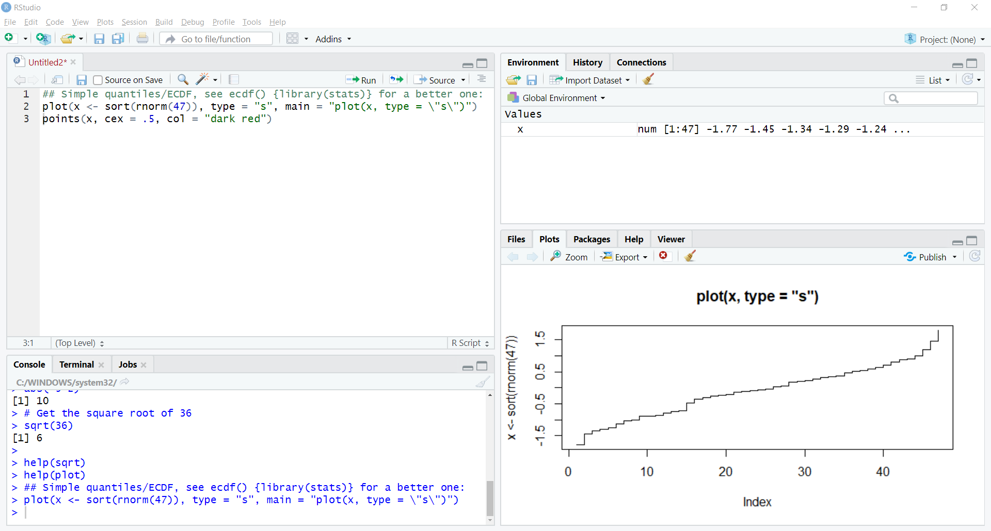
Plotting an example

Slide 34
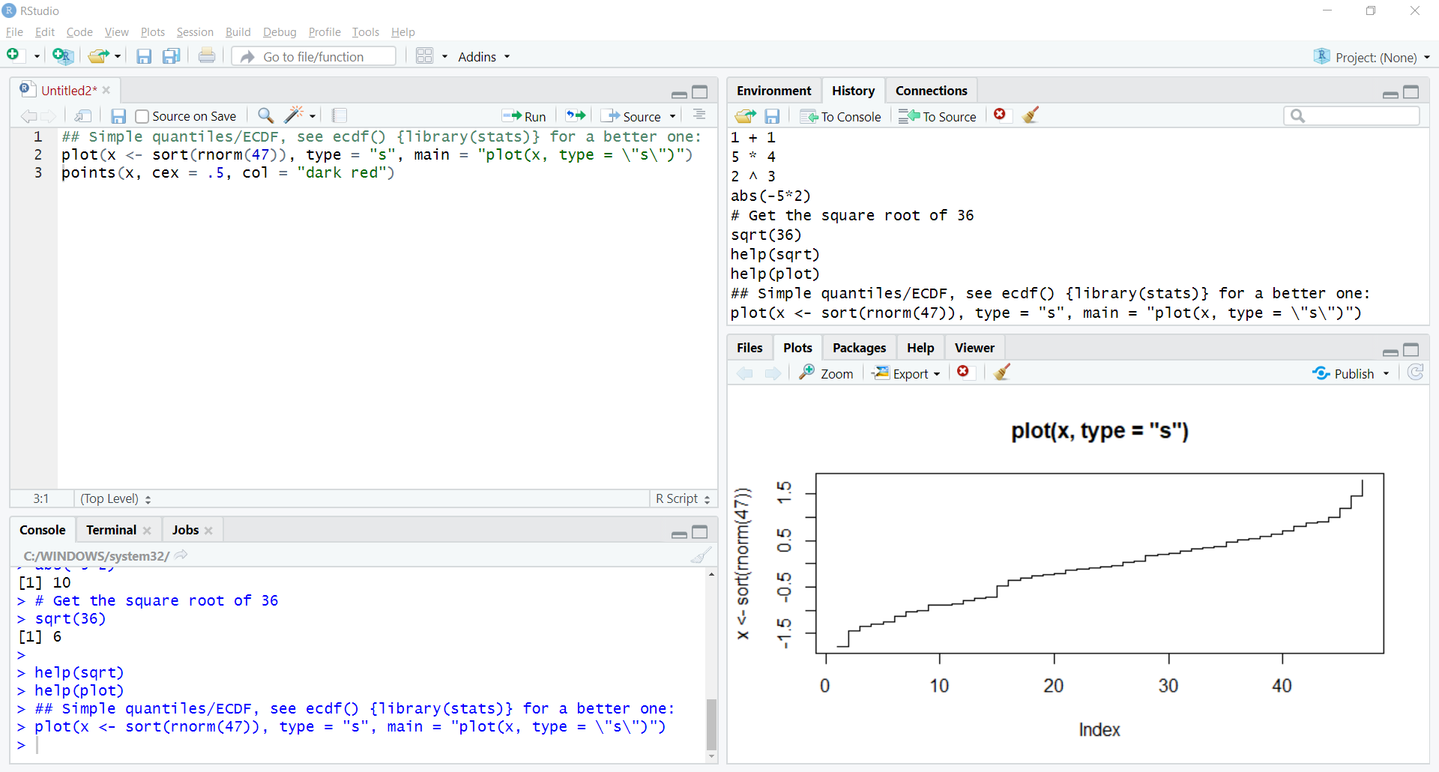
Viewing “R” history

Slide 35
Where did x come from? Us!

Slide 36
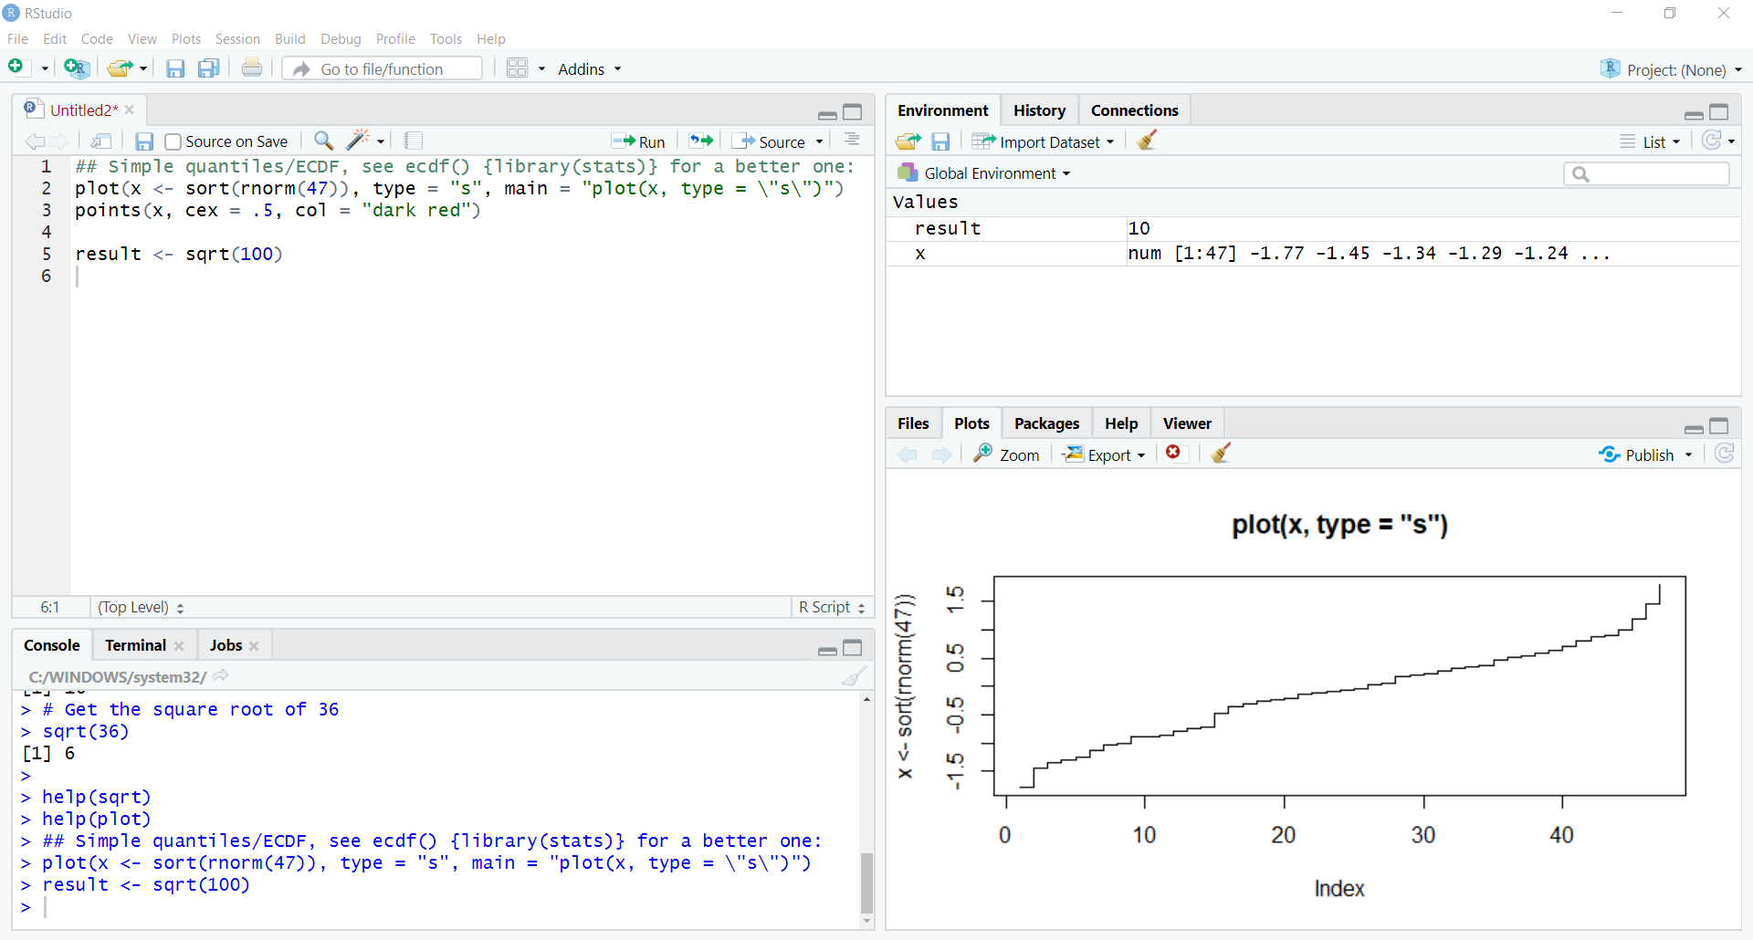
Assigning another object

Slide 37
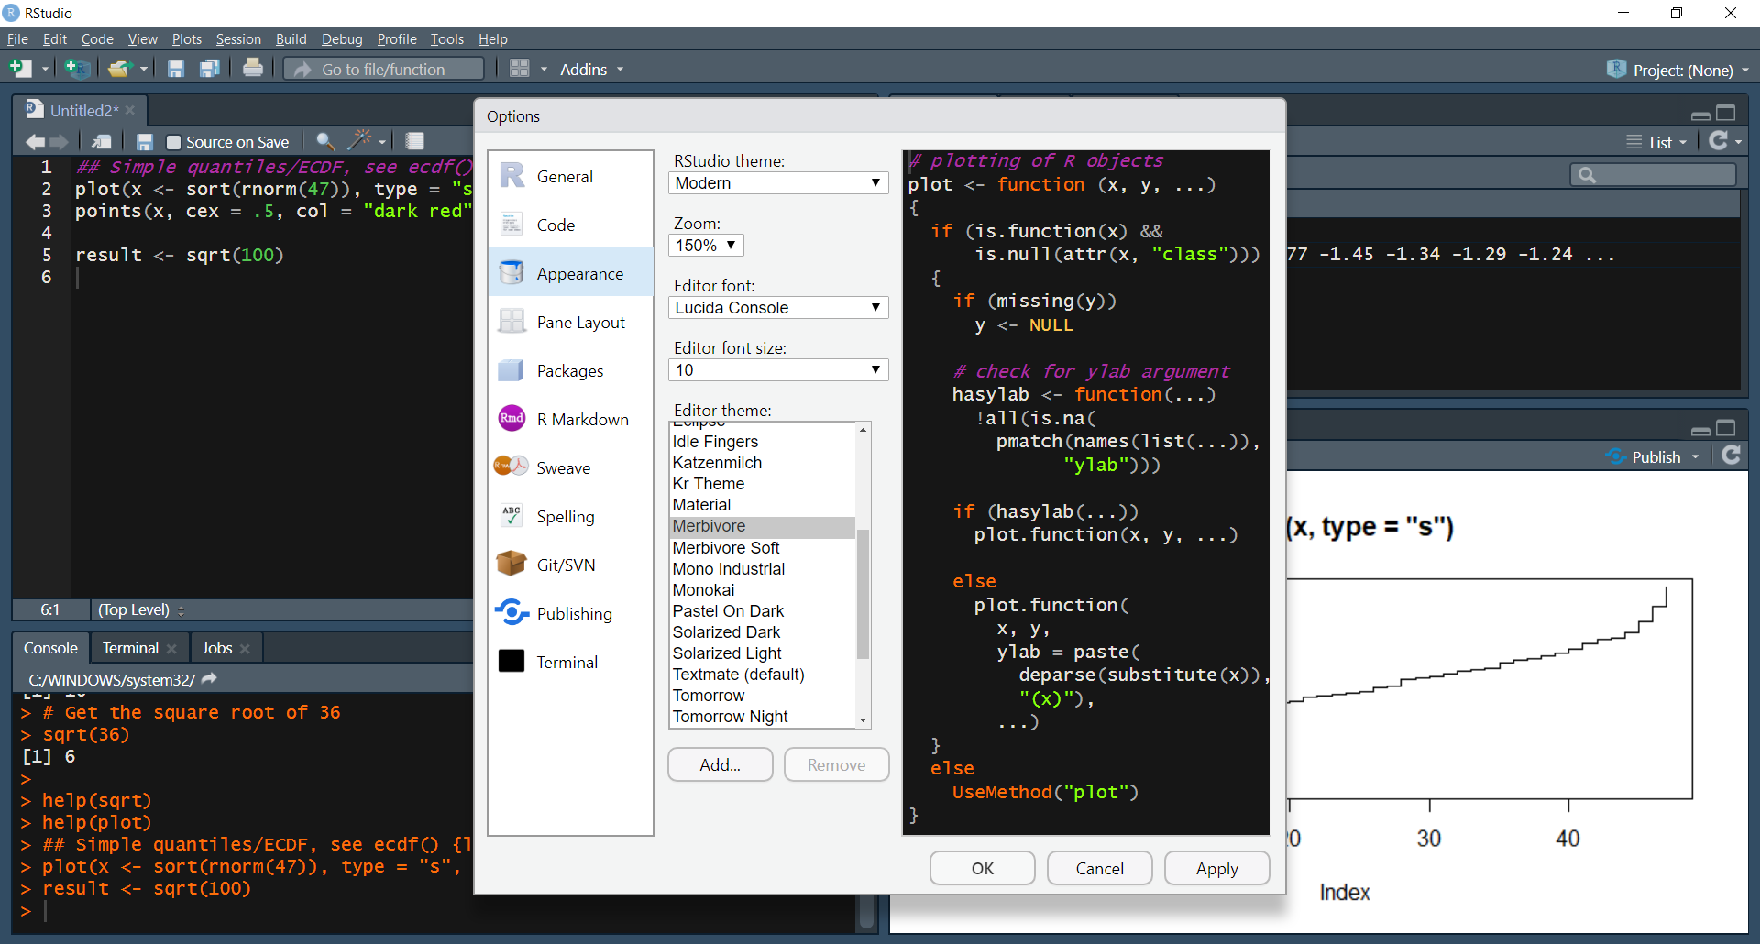
Now for something fun…

Slide 38
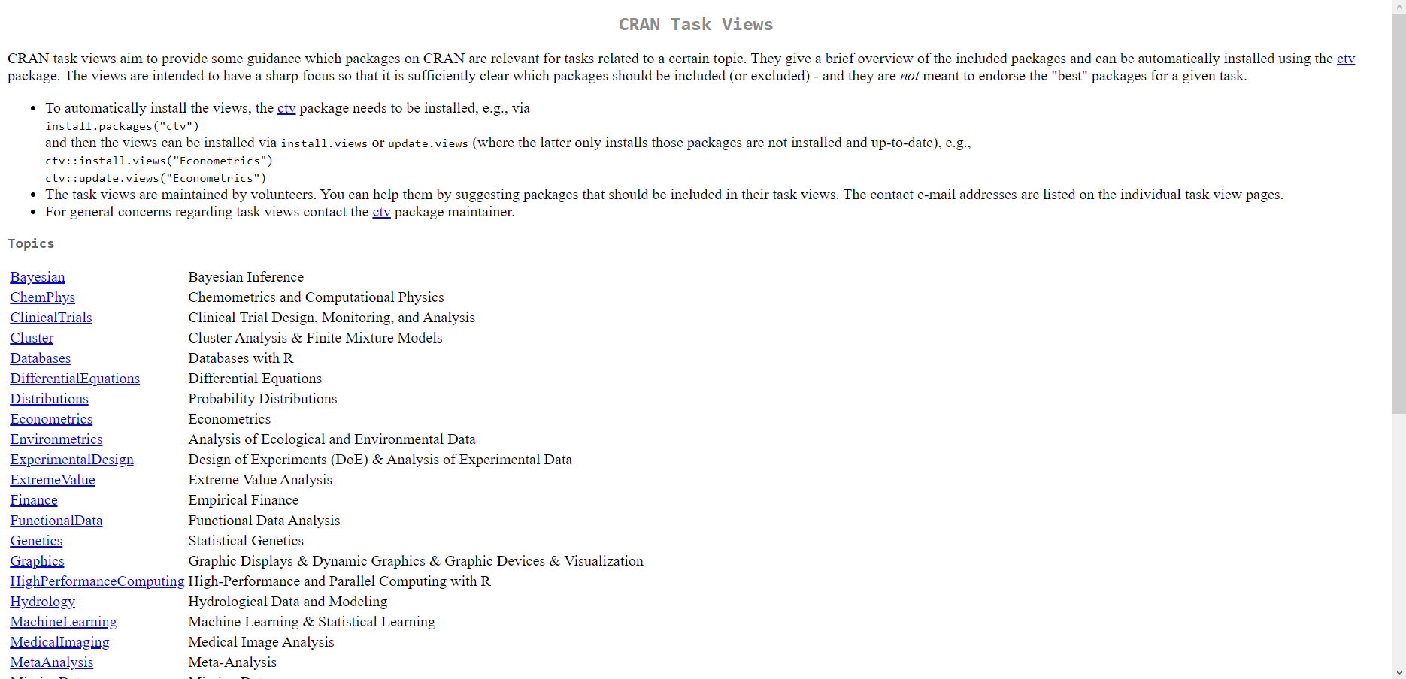
Spinning package playlists: CRAN task Views
https://cran.r-project.org/web/views/

Slide 39
ctv: a package to install other packages:
# Install task views package
install.packages("ctv")
# Load task views package
library(ctv)
# Install Econometrics task view
install.views("Econometrics")

Slide 40
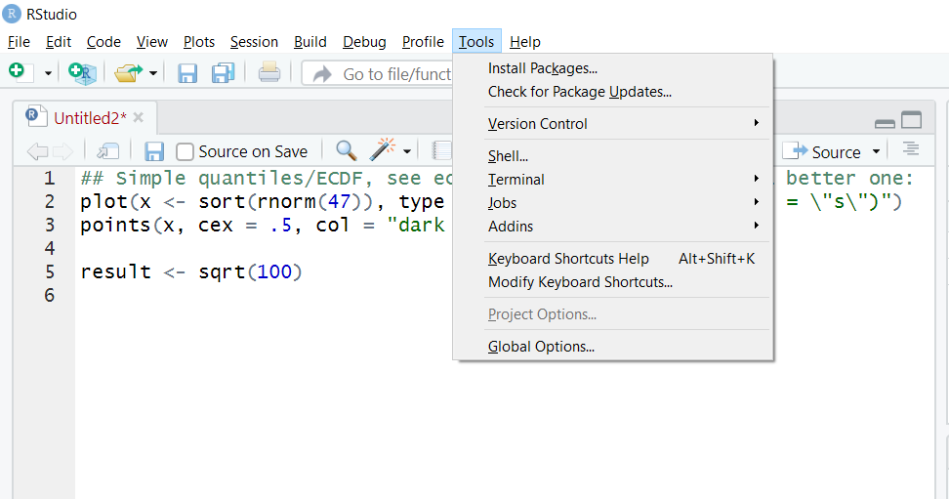
Checking for package updates

Slide 41
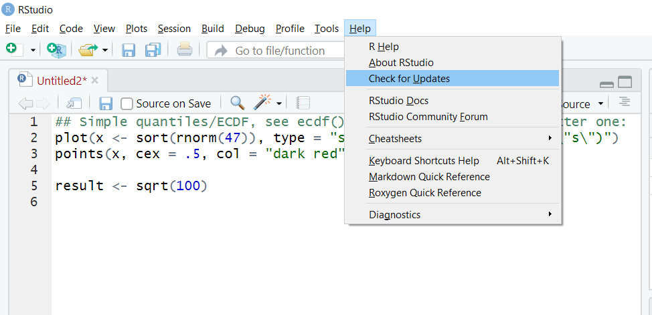
Checking for Rstudio updates

Slide 42
DRILLS
Load the tidyverse package
Call the help documentation on the subset() function
Install the ExtremeValue task view

Slide 43
Questions?

Slide 44

Creating objects
R stores data and output in objects

Slide 45
Creating objects
One option: equals sign (=)
#assign the value of the square root of 100 to
#the object, variable 'result'
result = sqrt(100)

Slide 46
Creating objects
Another (preferred) option: <- (Alt + M)
#assign the value of the square root of 100 to
#the object, variable 'result'
result <- sqrt(100)

Slide 47
Printing objects
#assign the value of the square root of 100 to
#the object, variable 'result'
result <- sqrt(100)

Slide 48
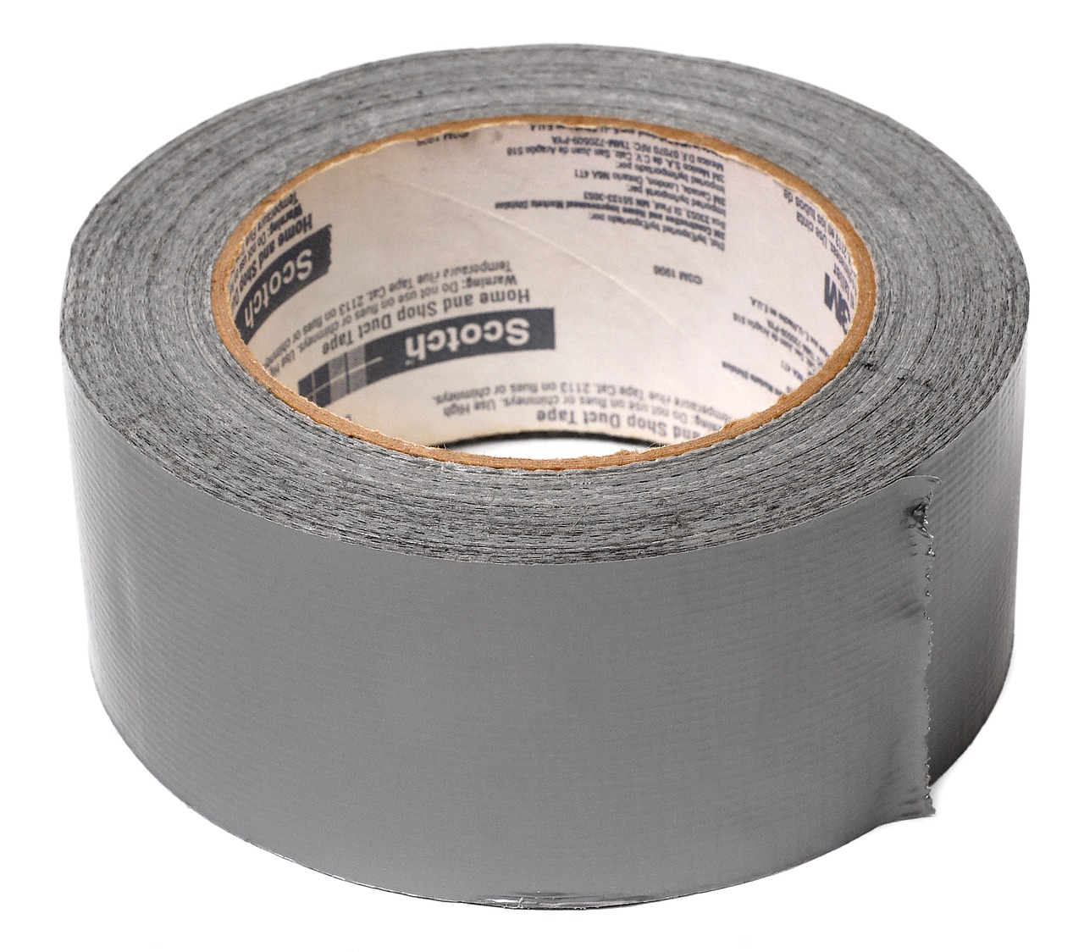

FROM VLOOKUP() DUCT TAPE TO JOIN() BLOWTORCH

Slide 49
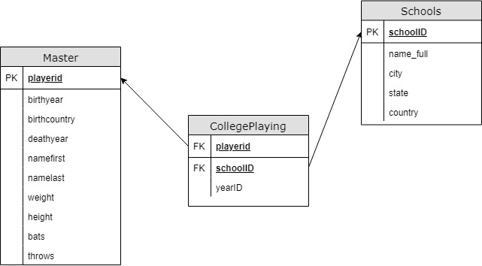
Introducing schemas

Slide 51
Resources

Slide 52
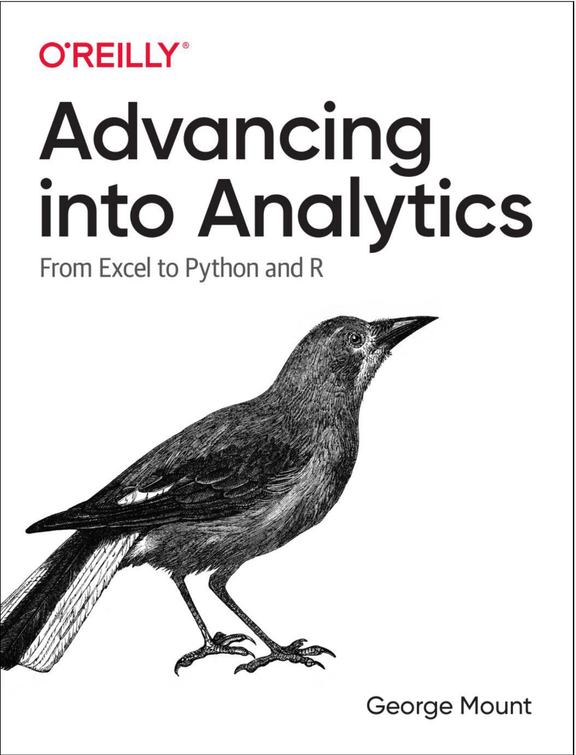
Buy my book
http://georgejmount.com/book/
Learning objective: By the end of this book, you should be able to conduct exploratory data analysis and
hypothesis testing using a programming language.

Slide 53
After you’ve bought my book
R for Data Science by Hadley Wickham and Garrett Grolemund
Python for Data Analysis, 2nd Edition by Wes McKinney
Python for Excel by Felix Zumstein

Slide 54
Get in touch
george@stringfestanalytics.com
stringfestanalytics.com/book
linkedin.com/in/gjmount

